Slide 1
Potential Benefits, Limits and Costs of Parallel Programming

Slide 2
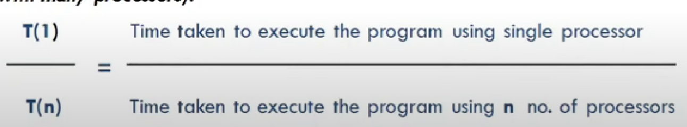
Amdahl's Law
Amdahl's Law states that potential program speedup is defined by the fraction of code (P) that can be parallelized.
Speed Up:
Speed up metric is a quantitative measure of performance , which defines benefit of running a program in parallel
Speedup metric is a quantitative measure of performance , which defines benefit of running a program in parallel.
S(n) =

Slide 3
Amdahl’s Law tells that for a given problem size, the speedup doesn’t increase linearly as the number of processors increases.
In fact speed-up tends to become saturated.
Amdahl’s law states that a small portion of the program which cannot be parallelized ( serial part ), will limit the overall speed-up available from parallelization
Typically any large mathematical or engineering problem consist of several parallelizable parts and several (non- parallelizable) parts.
Computation Problem = Serial Part + Parallel Part
The speed up of a program of using multiple processors in parallel computing is limited by the time needed for the sequential fraction (n0n- parallelizable part ) of the program.

Slide 4
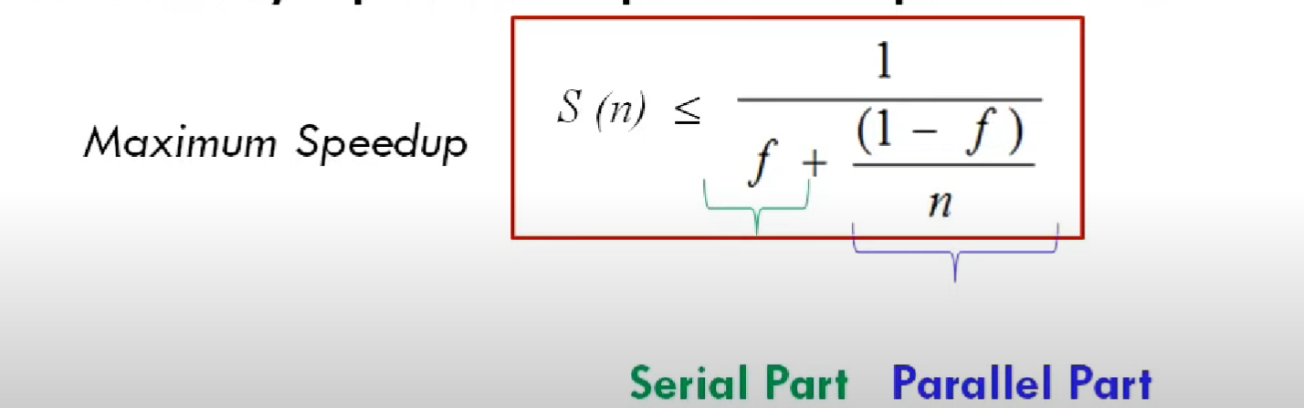
Let f be the fraction of operations in a computation that must be performed sequentially , where 0<= f <= 1. The maximum speedup achievable with n processors is

Slide 5
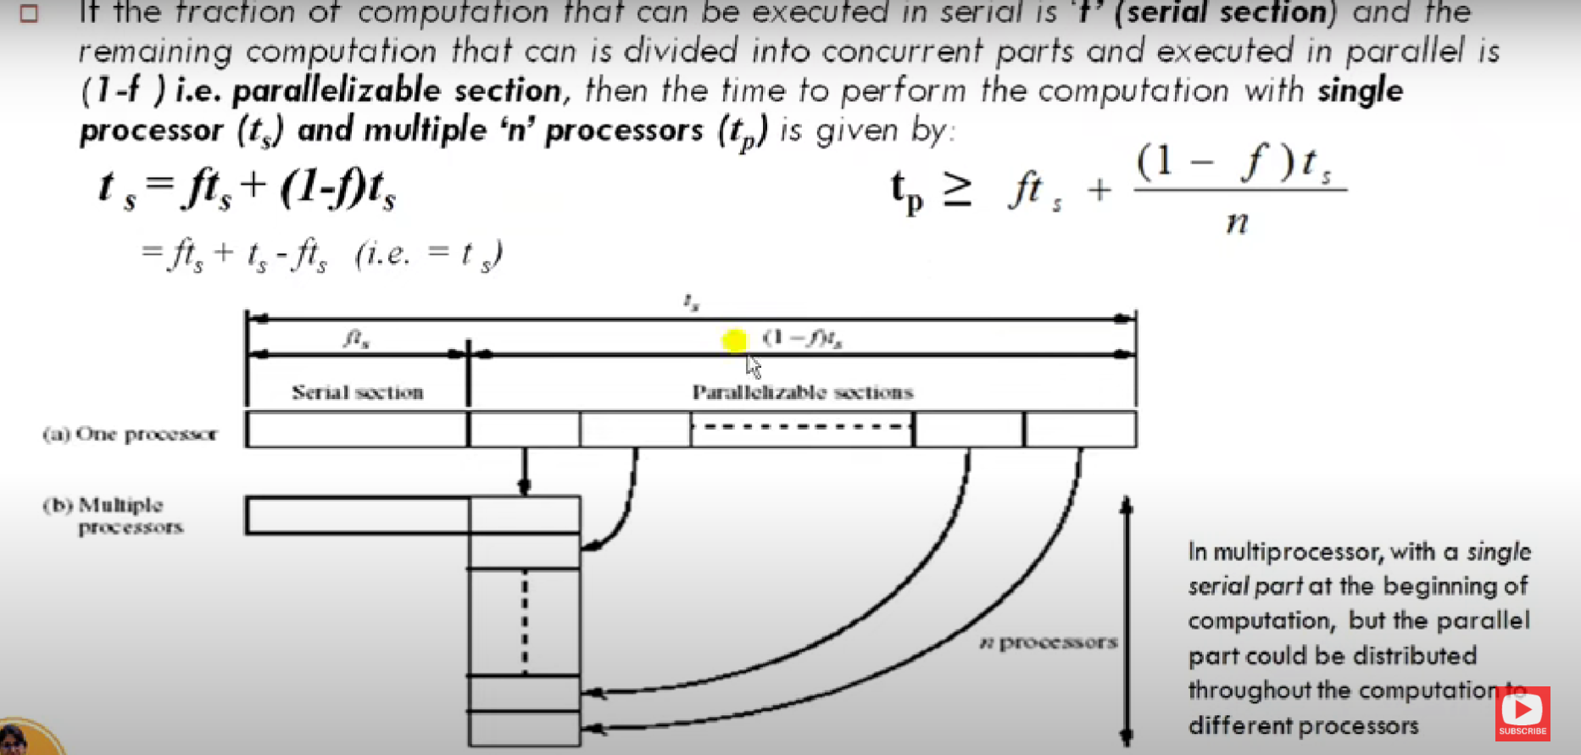
PROOF OF AMDAHL’S LAW

Slide 6
REVIEW AND LIMITATION OF AMDHAL’S LAW
Treats problem size as a constant.
It shows how execution time decreases as number of processors increases.
Amdahl’s Law assumes that minimizing execution time is the focus of parallel computing.
It treats the problem size as constant and demonstrates that increasing processors can reduce time.
Currently it is generally accepted by parallel computing professionals that Amdahl’s law is not a serious limit to the benefit and future of parallel computing.

Slide 7
Gustafson Law
This law says that increase of problem size for large machines can retain scalability with respect to the number of processors.
The problem size increases at the same rate as the number of processors
The problem size per processor stays fixed as more processors are added. The total problem size is proportional to the number of processors used.
Goal is to run larger problem in same amount of time

Slide 8
Complexity
In general, parallel applications are more complex than corresponding serial applications. Not only do you have multiple instruction streams executing at the same time, but you also have data flowing between them.
The costs of complexity are measured in programmer time in virtually every aspect of the software development cycle:
  Design
  Coding
  Debugging
  Tuning
  Maintenance
Adhering to "good" software development practices is essential when developing parallel applications.

Slide 9
Portability
Portability issues with parallel programs are not as serious as in years past. However...
All of the usual portability issues associated with serial programs apply to parallel programs. For example, if you use vendor "enhancements" to Fortran, C or C++, portability will be a problem.
Even though standards exist for several APIs, implementations will differ in a number of details, sometimes to the point of requiring code modifications in order to effect portability.
Operating systems can play a key role in code portability issues.
Hardware architectures are characteristically highly variable and can affect portability.

Slide 10
Resource Requirements
The primary intent of parallel programming is to decrease execution wall clock time, however in order to accomplish this, more CPU is required.
The amount of memory required can be greater for parallel codes than serial codes, due to the need to replicate data and for overheads associated with parallel support libraries and subsystems.
For short running parallel programs, there can actually be a decrease in performance compared to a similar serial implementation.
The overhead costs associated with setting up the parallel environment, task creation, communications and task termination can comprise a significant portion of the total execution time for short runs.

Slide 11
Scalability
Two types of scaling based on time to solution: strong scaling and weak scaling.
Strong scaling (Amdahl):
  The total problem size stays fixed as more processors are added.
  Goal is to run the same problem size faster
  Perfect scaling means problem is solved in 1/P time (compared to serial)
Weak scaling (Gustafson):
  The problem size increases at the same rate as the number of processors
  The problem size per processor stays fixed as more processors are added. The total problem size is proportional to the number of processors used.
  Goal is to run larger problem in same amount of time

Slide 12
The ability of a parallel program's performance to scale is a result of a number of interrelated factors. Simply adding more processors is rarely the answer.
The algorithm may have inherent limits to scalability. At some point, adding more resources causes performance to decrease. This is a common situation with many parallel applications.
Hardware factors play a significant role in scalability. Examples:
  Memory-CPU bus bandwidth on an SMP machine
  Communications network bandwidth
  Amount of memory available on any given machine or set of machines
  Processor clock speed
Parallel support libraries and subsystems software can limit scalability independent of your application.

